Slide 1
Helping Businesses Make the Shift to Electric Fleets

Slide 2
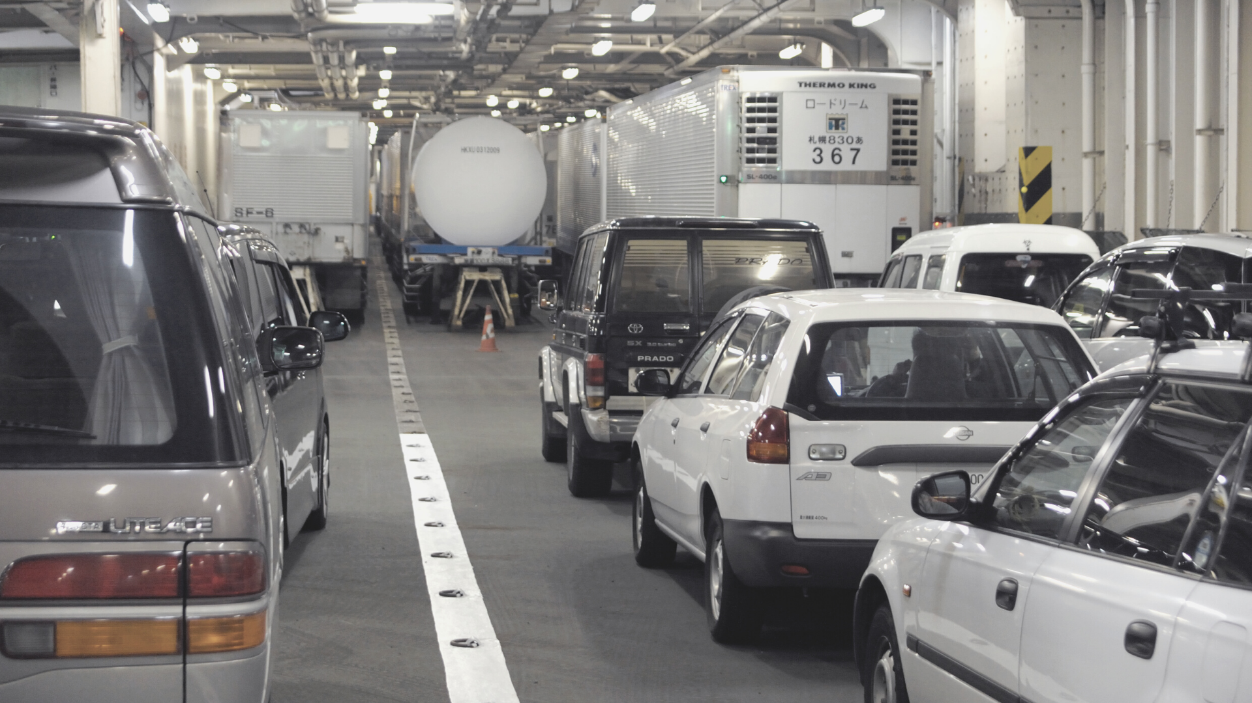
The future is electric.
We’re helping businesses prepare for the transition to electric fleets. Helping them make informed decisions now that will save money & cut emissions in the future.

Slide 3
For Discussion
Helping you understand your electric vehicle options
Assessing your EV charger and infrastructure needs
Leveraging grants and incentives
Addressing operation & maintenance

Slide 4
Helping you understand your
Electric vehicle options

Slide 5
Understanding your electric vehicle options
Step 1
Step 2
Step 3
Collect Fleet Data
Identify EV Options
Make Optimal Choices
We combine your fleet inventory, operations and fuel data to better understand your needs.
We compare your fleet against electric, hybrid and gas vehicles to help you understand the alternatives.
We help build your business case for fleet electrification and get started on your implementation plan.

Slide 6
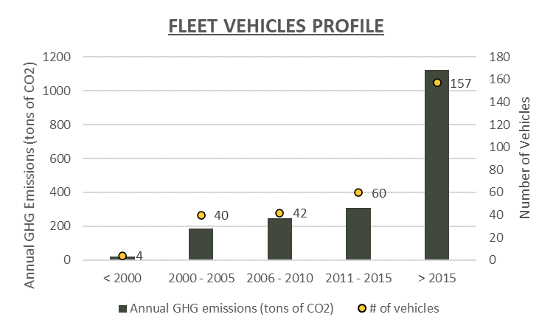
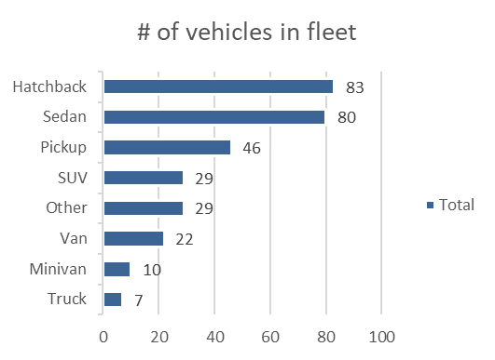
Collecting Your Fleet Data
We consolidate your data to better understand your fleet’s specific needs:
Fleet inventory
Operations (odometer, fuel, telematics, maintenance)
Parking locations

Slide 7
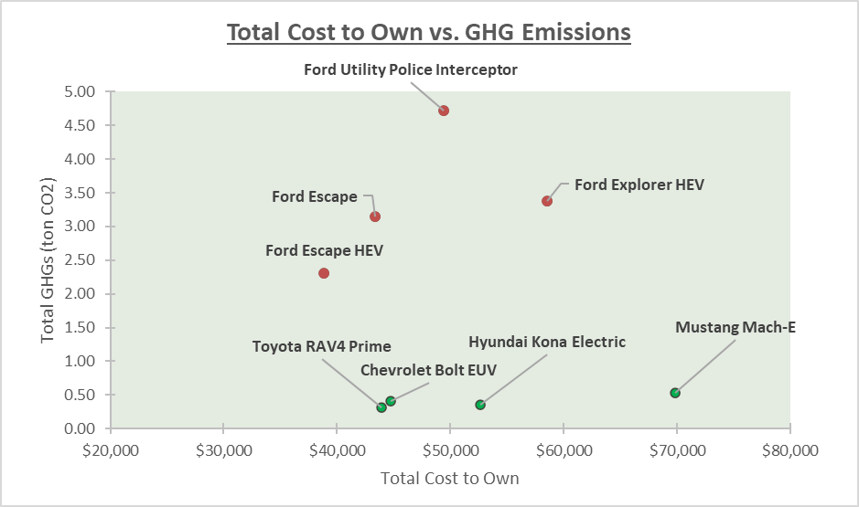
Selecting Electric and Hybrid Vehicles
We help you find the right vehicles for your specific fleet needs:
Mathematical models and software to evaluate your driving needs
Proprietary vehicle database includes hundreds of light, medium, and heavy-duty vehicles to determine the right fit

Slide 8
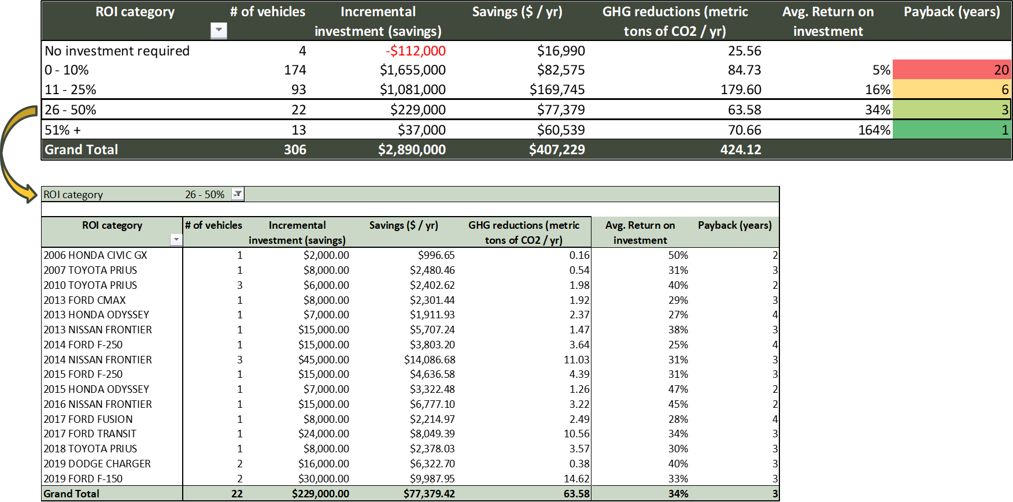
Calculating ROI on Your Fleet Transition
We help you prioritize return on investment:
Find which vehicles to replace first
Maximize the financial and environmental benefits for your fleet

Slide 9
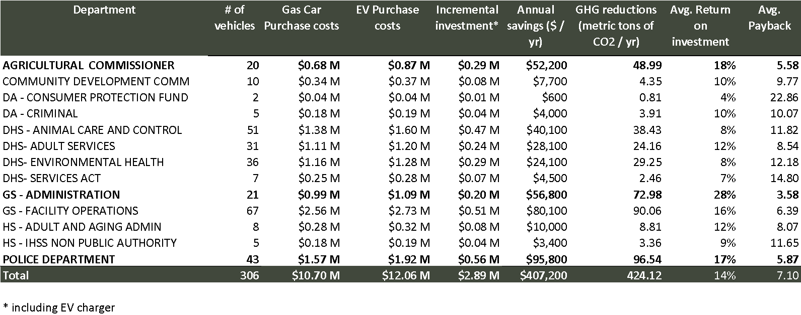
Going Further to Optimize ROI by Department
COMMUNITY SERVICES
PUBLIC ADMIN
We calculate your results and help you make better decisions

Slide 10
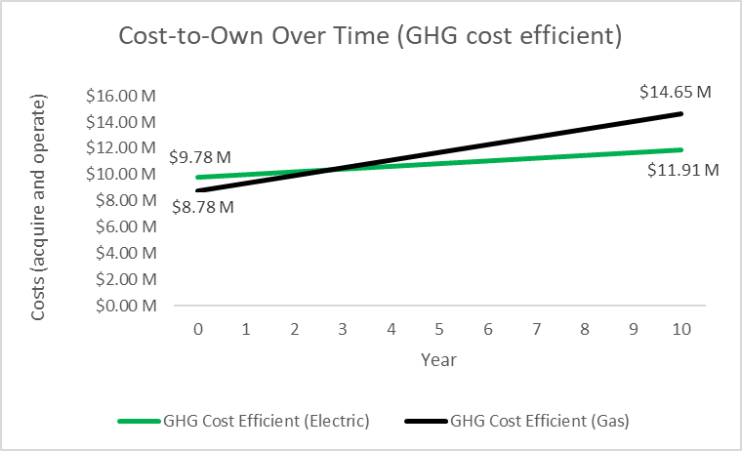
Making the Optimal Choices
We help you determine which vehicles provide:
The highest return on investment
The best GHG reduction cost-efficiency

Slide 11
The Journey to Fleet Electrification
1
2
3
4
5
Fleet Data Collection
Data Analysis & Vehicle Selection
EV Readiness Assessment
EV Infrastructure Design & Build
Operation & Maintenance
We aggregate all your fleet inventory, operations and fuel data to better understand your needs.
We compare your current fleet against the electric & hybrid vehicle options and help you build the business case for electrification.
We conduct a thorough analysis of your building’s electrical system capacity to determine if it can handle the additional EV load requirements.
We provide a detailed estimate and recommend the best-fit chargers and EV infrastructure to meet your needs. We manage the entire project from design to installation.
We ensure that your EV equipment is maintained for optimal performance.

Slide 12
Assessing your EV charger and
infrastructure needs

Slide 13
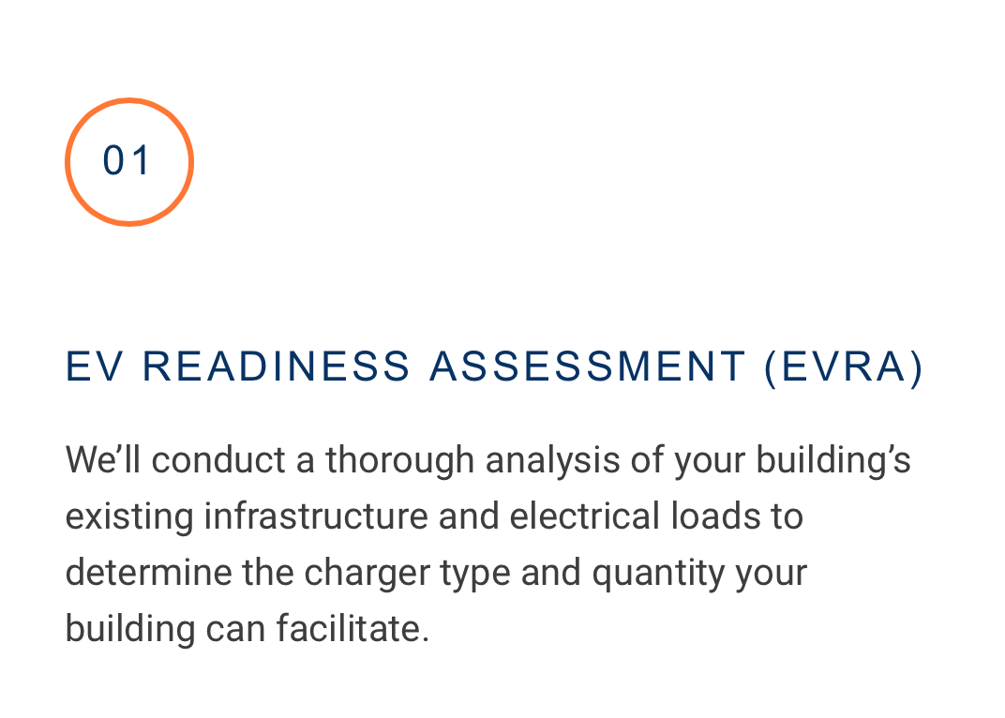
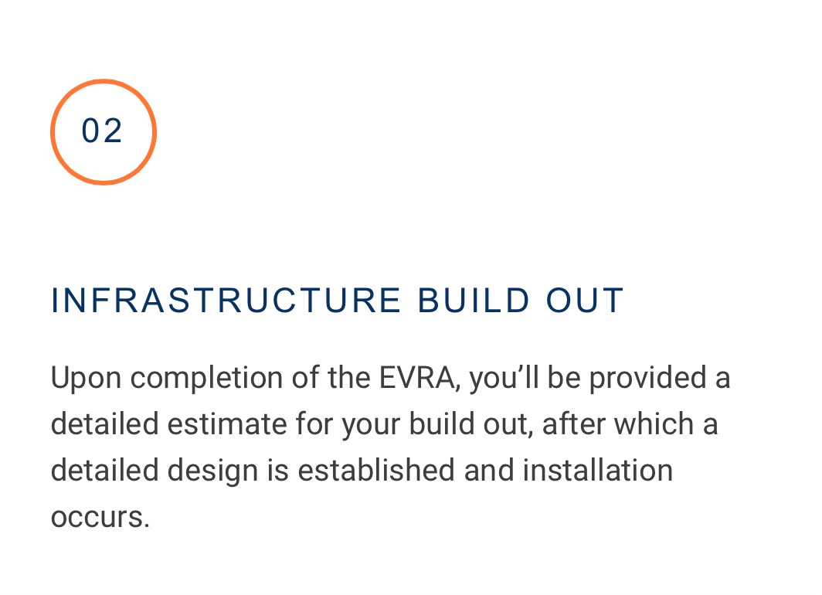
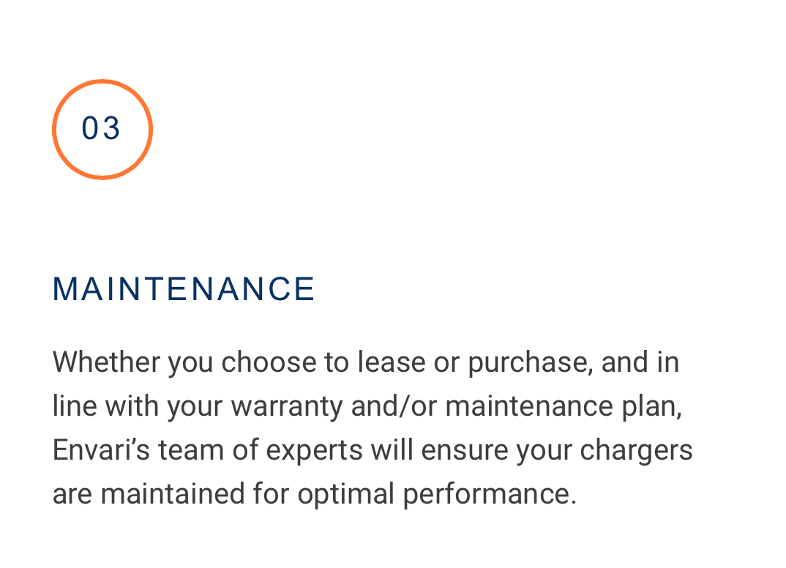
Assessing your EV charger and infrastructure needs
What’s involved?
A
B
C
Electric Vehicle Readiness Assessment (EVRA)
EV INFRASTRUCTURE (Design & Build)
OPERATION & MAINTENCE
We’ll conduct a thorough analysis of your building’s electrical system to determine if there is spare capacity to handle the additional EV load. We’ll recommend the charger type and quantity.
We’ll provide you with a detailed cost estimate for the best-fit EV chargers and infrastructure to meet your needs. We’ll manage the entire project from design to installation.
We’ll ensure that your EV equipment is maintained for optimal performance.

Slide 14
Electric Vehicle Readiness Assessment (EVRA)
Review the size of the electric system and metering configuration
Review the secondary electrical system voltage and configuration
Review the building’s average electrical demand loading
Confirm the age and assess the condition of the current electrical system
Determine available electric load to support your EV needs
Discuss your current and future electrical needs
Recommend the best options and provide price estimates for EV chargers, EV infrastructure and equipment installation

Slide 15
EV Infrastructure (Design & Build)
Consider the need for sub-metering (if required)
Provide estimate for electrical system up-grades (if required)
Provide estimates for best-fit EV chargers to meet customer needs (technology agnostic)
Provide estimate for installation costs for wall-mounted and/or pedestal options
Determine power sharing requirements (if required)
Provide price estimates for software and network connections
Leverage grants & incentives to offset investment costs

Slide 16
Operation & Maintenance
5 Year manufacturer’s warranty
Yearly inspection of EV chargers and infrastructure
Maintenance of EV equipment
Replacement of damaged equipment
Cable management

Slide 17
The 5 Step Journey to Fleet Electrification

Slide 18
The Journey to Fleet Electrification
1
2
3
4
5
Fleet Data Collection
Data Analysis & Vehicle Selection
EV Readiness Assessment
EV Infrastructure Design & Build
Operation & Maintenance
We aggregate all your fleet inventory, operations and fuel data to better understand your needs.
We compare your current fleet against the electric & hybrid vehicle options and help you build the business case for electrification.
We conduct a thorough analysis of your building’s electrical system capacity to determine if it can handle the additional EV load requirements.
We provide a detailed estimate and recommend the best-fit chargers and EV infrastructure to meet your needs. We manage the entire project from design to installation.
We ensure that your EV equipment is maintained for optimal performance.

Slide 19
The Envari Advantage
Trusted experts As part of the Hydro Ottawa Group of Companies, we bring decades of energy-management innovation to every project for smarter, greener solutions.
Full transparency We value partnerships, not transactions, which is why we’re always clear on details, challenges, and costs.
Integrity and education We take the time to truly understand your vision and key drivers for success, guiding you every step of the way.
Technology agnostic Our product recommendations are always unbiased. We focus on finding the best-fit, best-value solution every time.
Committed to quality We adhere to the highest standards of safety and reliability. Our long-standing relationships with local contractors and vendors to ensure quality from start to finish.
Energy obsessed We go above and beyond to find creative ways to optimize your energy portfolio and reduce your carbon emissions.
Concept to commissioning We’re more than just a consulting company – we design & build energy solutions. From identifying milestones to mitigating risk to managing all stakeholders involved, we’ll oversee your entire project or any stage along the way.

Slide 20
Next Steps - Discussion

Slide 24
Jim Pegg P.Eng., PMP
Director, Infrastructure Products and Services Directeur, Produits et services d’infrastructure
t 613.321.8274, ext./poste 7118 jimpegg@envari.com

